Slide 1
Action Research Project: Increasing Participation in Tutorials
James Venning | 13th January 2025
PgCert Academic Practice in Art, Design & Communication
Notes:
Good morning. My name
I’m presenting my Action Research Project,
explores strategies to increase equitable participation in Year Lead and Unit tutorials within the BA (Hons) Fashion Buying and Merchandising program.

Slide 2
Introduction and Context
Aim: Investigate barriers to participation in tutorials and propose equitable strategies to improve these and address the following;
  Context - Social Justice : Tutorials are key to learning but often exclude marginalised groups due to systemic barriers (Hooks, 1994 ; Freire, 2000).
  Why This Matters: Diverse, large global cohorts (e.g., international students) face specific challenges such as Social anxiety, cultural and language barriers.
Notes:
Aim
low participation,
make them more inclusive and engaging
aligns with UAL's commitment to social justice and inclusivity in education.
Context - Inspired by Freire’s (2000) emphasis on dialogue hooks’ (1994) vision of inclusive classrooms, I aimed to address these issues through action research.

Slide 3
Research Question and Methodology
Research Question:
How can participation methods and dialogue-building techniques from large cohort courses such as the BA (Hons) in Fashion Buying and Merchandising be adapted to increase equitable engagement in Year Lead and Unit tutorials, addressing social, cultural, and racial barriers?
Methods:
  Student and staff surveys (quantitative + qualitative) – Perspectives range.
  39 student responses (81.25%), 9 staff responses (50%).
  Thematic analysis (Braun & Clarke, 2006) to identify recurring patterns and actionable themes.
Ethical Considerations: Anonymity, consent, care (BERA, 2024).
Notes:
range of perspectives.
Ethical considerations were a priority to respect and protect participants.
Responses were anonymised, to share their honest perspectives.
Clear consent process at the beginning of each survey,
BERA (2024), particularly regarding participant care.
mindful of the emotional and cultural dynamics when designing the survey questions, ensuring they were respectful, accessible, and free from bias.
Voluntary nature of their involvement
Bryman (2016) also notes that surveys provide anonymity, which can reduce social desirability bias and lead to more honest responses especially on sensitive issues like race, class, and culture.
Thomas and Harden (2008) argue that written surveys allow respondents to process questions at their own pace, encouraging reflection and more in-depth responses.

Slide 4
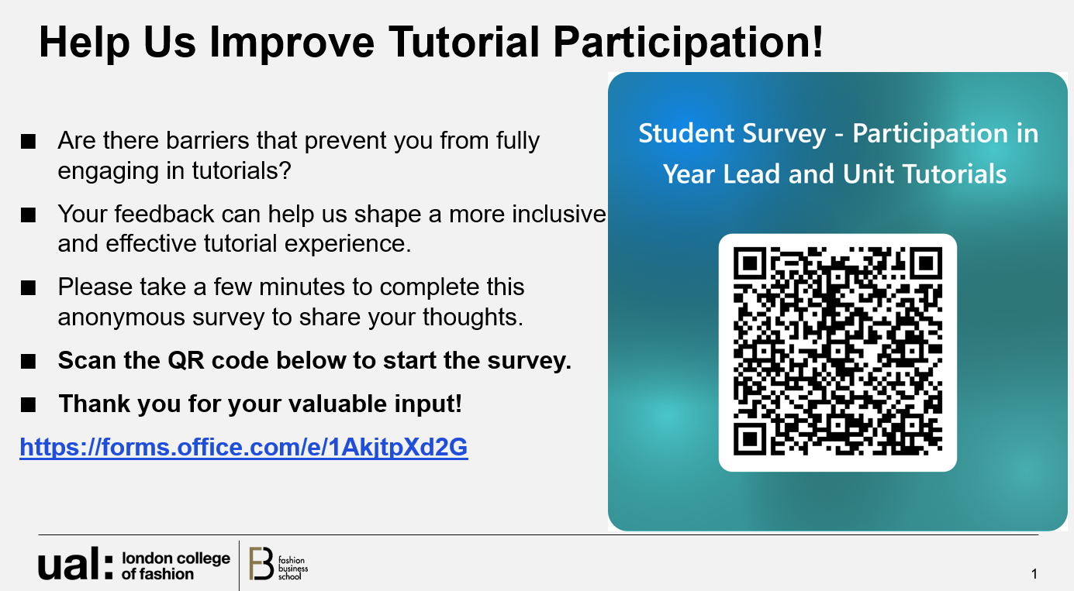
Data Collection
Challenges: Initial low student response to passive survey distribution (emails, slides).
Key Intervention: Face-to-face collection during lecture → boosted response rate from 13 to 39.
Reflection: Demonstrates importance of direct interaction in research participation.
  value of real-time explanation
  build trust

Slide 5
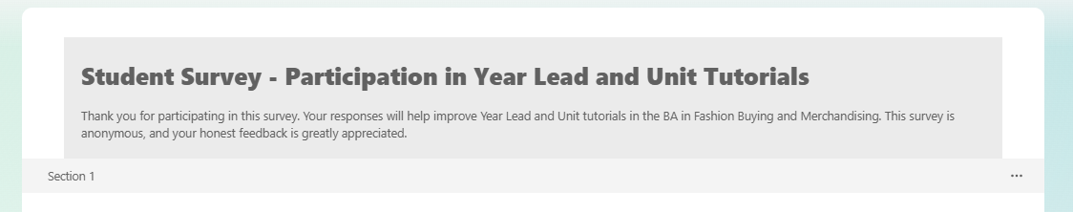
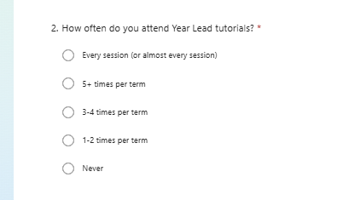
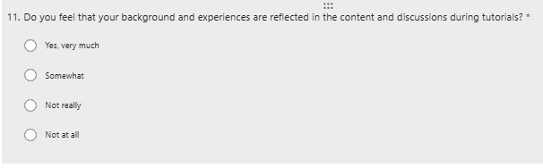
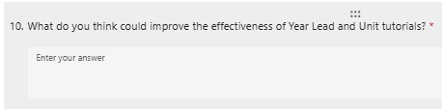
Overview of Surveys
Student Survey:
17 questions: 30% Open and 70% closed-ended.
Covering:
  Attendance,
  Participation barriers,
  Perceptions of effectiveness,
  Inclusivity representation,
  Technology/access
  Preferred tutorial formats.
Notes:
In this research, I utilised two surveys to gather data from students and staff, each tailored to explore barriers and strategies for enhancing tutorial participation. Here's an overview of their design and structure:
closed-ended questions to quantify attendance patterns, participation levels, and barriers such as timing conflicts and social anxiety.
open-ended questions to allow students to elaborate on their experiences, such as suggestions for making tutorials more inclusive or effective.

Slide 6
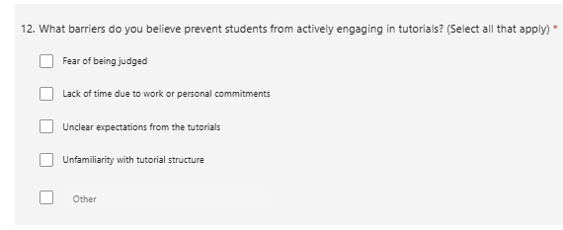
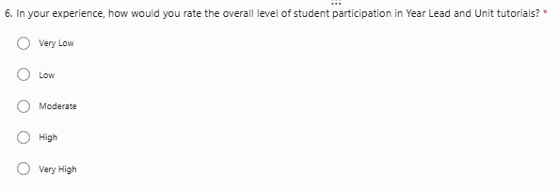
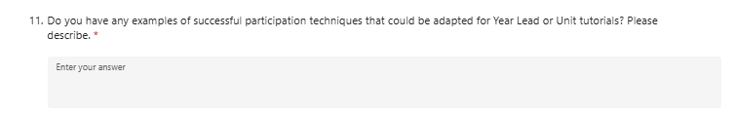
Overview of Surveys
Staff Survey:
16 questions: Open and closed-ended.
Focused on:
  perceptions of student participation,
  Engagement strategies/ effective teaching methods,
  Barriers to Participation
  Suggestions
Notes:
The variation in question styles across both surveys provided a comprehensive dataset, enabling thematic analysis that combined measurable trends and insights. This approach ensured that both student and staff voices were equally valued in identifying actionable strategies.
Quantitative focus: Participation levels and barriers.
Qualitative focus: Examples of successful techniques and strategies.

Slide 7
Unified Thematic Analysis
1. Attendance Patterns
Students: Sporadic attendance for Year Lead Tutorials (28% regular, 21% never attended); higher attendance for Unit Tutorials (41% regular).
Staff: 44% rated participation as "low" or "very low," citing timing and perceived lack of tutorial value as key issues.
Notes:
Attendance Patterns emerged as a core issue, with sporadic attendance and timing conflicts affecting engagement.
Student Quote - ‘Make sessions mandatory to ensure everyone attends.’

Slide 8
Unified Thematic Analysis
2. Barriers to Participation
Students: Top barriers include timing conflicts (51%), social anxiety (33%), and language challenges (21%).
Staff: Identified similar barriers, including fear of judgment (78%) and cultural/language challenges (67%).
Notes:
Barriers to Participation, including social anxiety and language challenges, were shared by students and staff. Addressing these will require cultural competency training and anonymous tools.

Slide 9
Unified Thematic Analysis
3. Inclusivity and Representation
Students: 62% feel their backgrounds are "somewhat" reflected, but call for more culturally relevant content.
Staff: 33% acknowledged diversity challenges, particularly around cultural norms and language issues.
Notes:
Inclusivity and Representation are central to creating equitable spaces, and students emphasised the need for content that reflects their diverse backgrounds.

Slide 10
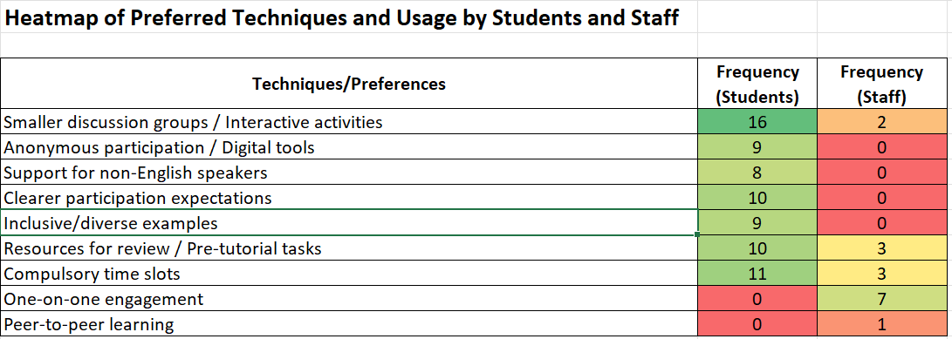
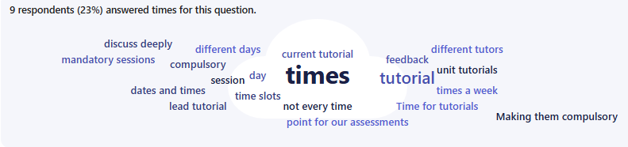
Unified Thematic Analysis
4. Preferred Formats and Techniques
Students: Favour hybrid formats, smaller groups (41%), interactive methods (e.g., breakout rooms & digital tools) and Time flexibility.
Staff: Rely heavily on one-on-one engagement (78%) but underutilise interactive techniques (22%).
Improve effectiveness Word Cloud
Notes:
Preferred Formats and Techniques highlighted the gap between student preferences for interactive methods and the traditional approaches often used by staff.

Slide 11
Unified Thematic Analysis
5. Communication and Clarity
Students: Emphasised need for clear objectives, structured agendas, and pre-session resources.
Staff: Stressed importance of well-organised tutorials and pre-tutorial preparation.
Notes:
Lastly, Communication and Clarity were consistent themes, as both groups emphasised the importance of clear objectives and structured support materials.

Slide 12
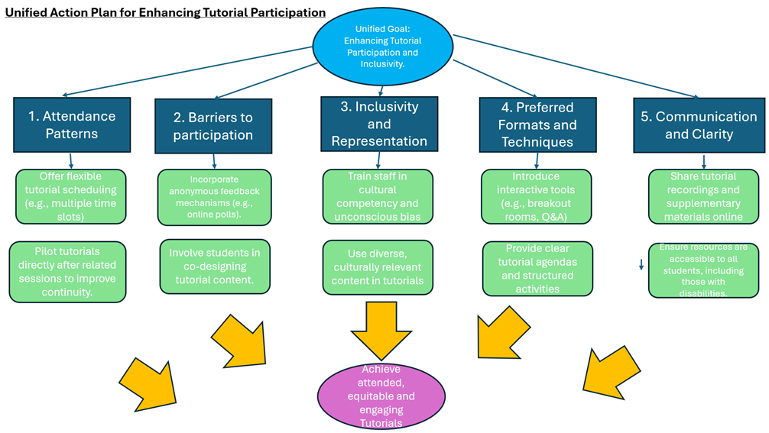
Notes:
Flexible tutorial scheduling
Provide clear tutorial agendas
Use Diverse culturally relevant content

Slide 13
Practical Implementation
Upcoming Changes:
  Roll out of mandatory tutorials (Feb 25)
        aligns with the findings of Braun and Clarke (2022), emphasising the need for structured participation strategies to address engagement barriers.
  Pilot hybrid tutorial formats (Jan 25)
    reflects Cohen et al.’s (2018) advocacy for flexible learning models to accommodate diverse student needs.
  Team meeting to implement cultural competency training (Date TBC)
        resonates with Hooks’ (1994) call for inclusive classrooms where diverse voices are recognised and valued.
  Trial Anonymous participation tools (Jan 25)
  Use digital tools like Padlet, allow students to submit questions/comments anonymously before, during of after tutorials. Supporting Freire’s (2000) vision of where all voices can contribute without fear.
Notes:
To implement these findings, I propose:
Rolling out mandatory tutorials from February to improve attendance and engagement.
Developing cultural competency training for staff, with a 2-hour workshop including case studies.
Piloting hybrid formats and small-group discussions to align with student preferences.
These steps aim to create an inclusive, supportive, and engaging tutorial environment.

Slide 14
Reflections on Methods
Strengths:
  Surveys captured diverse perspectives - aligning with Cohen et al (2018) emphasis on the effectiveness of surveys for diverse cohorts.
  Thematic analysis offered structured insights.
Challenges:
  Time-intensive due to non-identical survey questions reflect the complexity of aligning staff and student perspectives, as noted by Bryman (2016), who highlights the importance of consistency in mixed-methods research.
  Volume of questions.
  Limited narrative depth - is a common drawback of surveys, as Freire (2000) emphasises the importance of dialogue for deeper insights.
Notes:
Reflecting on my methods, I found:
Surveys were effective for capturing diverse perspectives but limited in depth.
Non-identical questions for students and staff made analysis more time-consuming.
Future iterations could benefit from focus groups or interviews for richer narrative insights.
Standardised questions would streamline future analysis.

Slide 15
Reflections on Methods
  Future Improvements:
  Focus groups, Interviews, observational studies for richer rounded insights highlighted by Freire (2000) to uncover complex social and cultural dynamics.
  Standardised questions across staff & students to streamline analysis. Bryman (2016) suggested consistency in research design
Notes:
Reflecting on my methods, I found:
Surveys were effective for capturing diverse perspectives but limited in depth.
Non-identical questions for students and staff made analysis more time-consuming.
Future iterations could benefit from focus groups or interviews for richer narrative insights.
Standardised questions would streamline future analysis.

Slide 16
Conclusion
Key Achievements:
  Identified & addressed systemic barriers (timing, anxiety, unclear expectations).
  Unified student and staff perspectives into actionable themes, ensuring diverse voices were represented.
  Implementing strategies aligned with UAL’s equity goals (mandatory tutorials, cultural competency training, hybrid formats).
Impact:
  A foundation for more inclusive and engaging tutorials.
  Scalable solutions for other large, multicultural cohorts at UAL.
“The classroom remains the most radical space of possibility.” – (Hooks, 1994)
Notes:
Moving forward, I hope to explore focus groups and observational studies to deepen our understanding of participation dynamics.

Slide 17
Presentation References
Braun, V. and Clarke, V. (2022) Thematic analysis: a practical guide to understanding and doing. Thousand Oaks: Sage. Available at: https://bit.ly/3ICHBEr (Accessed: 20th Oct 2024).
British Educational Research Association (BERA) (2024) Ethical guidelines for educational research. 5th edn. London: British Educational Research Association. Available at: https://www.bera.ac.uk/publication/ethical-guidelines-for-educational-research-fifth-edition-2024 (Accessed: [11/12/2024]).
Bryman, A. (2016). Social research methods (5th ed.). Oxford University Press.
Cohen, L., Manion, L., & Morrison, K. (2018). Research methods in education (8th ed.). Routledge.
Freire, P. (2000). Pedagogy of the oppressed. Bloomsbury.
Hooks, b. (1994). Teaching to transgress: Education as the practice of freedom. Routledge.

Slide 18

Questions?
Notes:
Thank you for your time. I’d love to hear your thoughts and questions.

Slide 19
Thank you
James Venning
j.venning@arts.ac.uk

Slide 20
Additional Slides for Q&A

Slide 21
Why Surveys?
Bryman (2016) also notes that surveys provide anonymity, which can reduce social desirability bias and lead to more honest responses especially on sensitive issues like race, class, and culture.
Thomas and Harden (2008) argue that written surveys allow respondents to process questions at their own pace, encouraging reflection and more in-depth responses.
bell hooks’ (2003) call for educational practices that empower all students to share their perspectives, especially those who may feel marginalised in traditional classroom settings.
capture the voices of students who might feel hesitant to participate in live discussions

Slide 22
Creating Surveys?
Decolonising the University by Bhambra, Gebrial, and Niṣanciolu (2018), which emphasises the importance of representing diverse experiences in educational settings
Converse and Presser’s (2011) Survey Questions: Handcrafting the Standardized Questionnaire, I prioritised clarity and simplicity
I specified options like “language differences,” and “Disability impacts,” also open ended options so they can share their own “previous educational experiences, inspired by Feigenbaum and Alamalhodaei The Data Storytelling Workbook (2020)
Closed-ended questions allowed me to gather standardised data across key themes

Slide 23
Creating Surveys?
I included questions that explicitly acknowledge different cultural experiences, such as: ‘’Do you feel that your background and experiences are reflected in the content and discussions during tutorials?”
I avoided questions that could be too personal or intrusive, focusing instead on general experiences rather than specifics
I ensured the survey is voluntary
making the survey clear and approachable for students of various backgrounds and abilities
I adjusted questions to capture both behavioural and emotional aspects of engagement. For instance, instead of asking broadly about participation, I included questions probing both attendance and the comfort level of expressing opinions in tutorials.

Slide 24
Creating Surveys?
Questions Covered:
  Student survey - Attendance patterns, barriers to participation, comfort levels, perceptions of inclusivity, and preferred tutorial formats.
  Experience levels, perceived student barriers, effective participation methods, use of dialogue-building techniques, and inclusivity challenges.

Slide 25
Thematic analysis
Braun and Clarke’s (2022) Thematic Analysis: A Practical Guide provides a practical framework for analysing textual data
  Their six-step method facilitates identifying, organising, and interpreting themes
  systematic exploration of the underlying themes that affect student participation, offering a structured approach to understanding how barriers manifest in specific patterns across the cohort
Familiarisation: I reviewed responses multiple times to note patterns and recurring ideas.
Coding: Each response was assigned a meaningful code. For example, “timing conflicts” became part of the “Attendance Barriers” theme.
Searching for Themes: Codes were grouped into broader categories. For example:
  Student Code: “Social Anxiety”
  Staff Code: “Fear of Judgment”
  Combined Theme: Barriers to Participation
Reviewing Themes: Themes were cross-referenced across student and staff data for consistency.
Defining Themes: Each theme was given a clear name and linked to actionable insights.
Reporting: Themes were synthesised into the unified analysis so it could be more easily summarised.

Slide 26
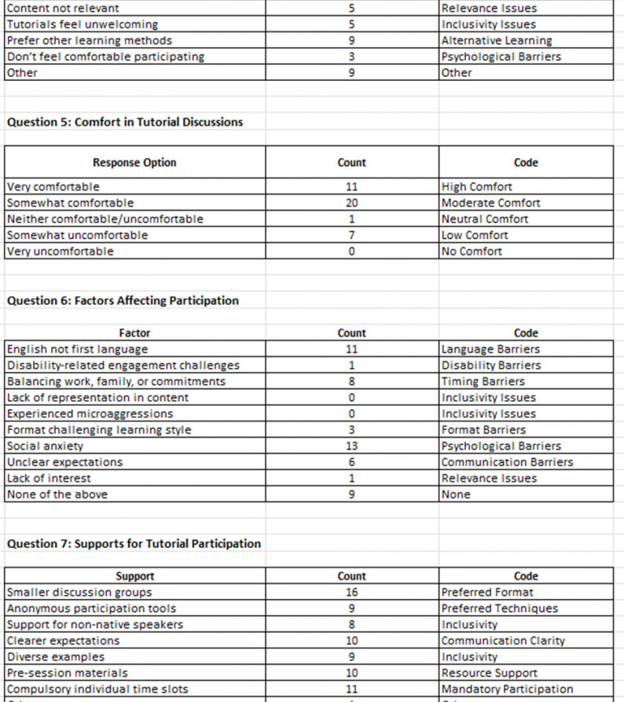
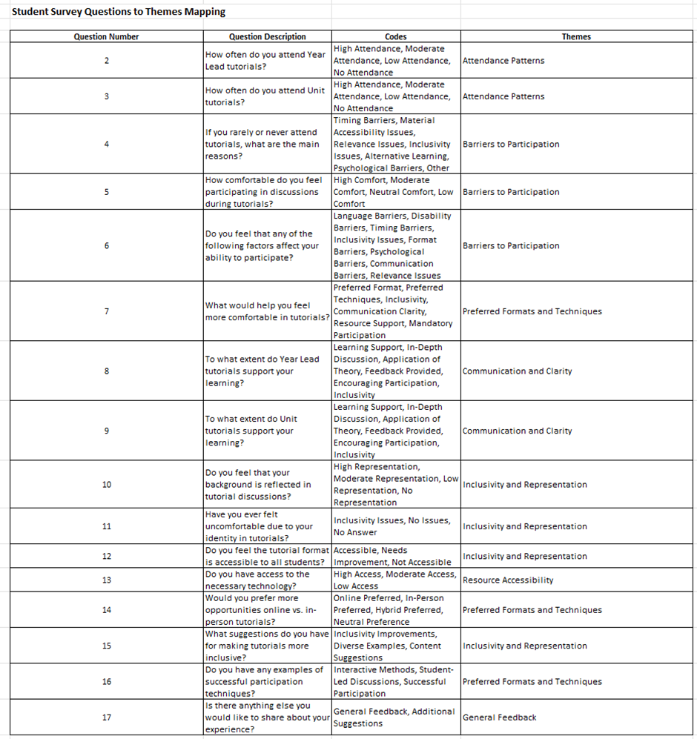
Thematic data examples

Slide 27
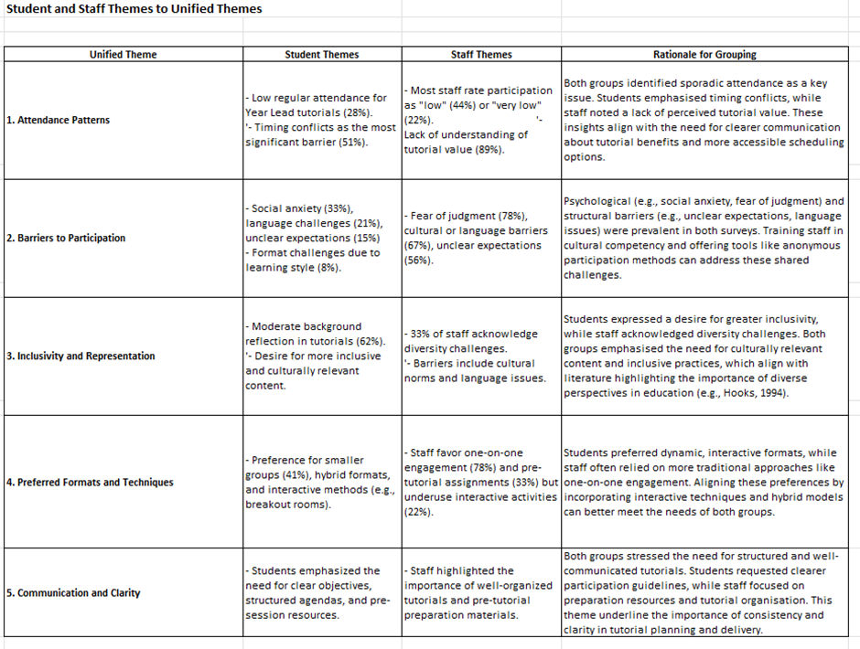
Unified Thematic Analysis
The final unified analysis combined insights from both surveys under five key themes:
Attendance Patterns: Sporadic attendance highlighted timing conflicts and perceived lack of tutorial value.
Barriers to Participation: Both students and staff identified psychological (e.g., fear of judgment) and structural barriers (e.g., unclear expectations).
Inclusivity and Representation: Students desired more culturally relevant content, while staff acknowledged diversity challenges.
Preferred Formats and Techniques: Students favoured hybrid and interactive formats; staff relied on traditional methods.
Communication and Clarity: Both groups emphasised the importance of clear objectives, agendas, and follow-up resources.

Slide 28
Q&A References
Bhambra, G., Gebrail, D., and Niṣancioǧlu, K. (eds.) (2018) Decolonising the University. London: Pluto Press.
Braun, V. and Clarke, V. (2022) Thematic analysis: a practical guide to understanding and doing. Thousand Oaks: Sage. Available at: https://bit.ly/3ICHBEr (Accessed: 20th Oct 2024).
Bryman, A. (2016). Social research methods (5th ed.). Oxford University Press.
Converse, J. M. and Presser, S. (2011) Survey questions: handcrafting the standardized questionnaire. Thousand Oaks: Sage. Available at: https://methods-sagepub-com.arts.idm.oclc.org/book/survey-questions/n3.xml (Accessed: 20th October 2024).
Feigenbaum, A. and Alamalhodaei, A. (2020) The data storytelling workbook. London: Routledge.
Hooks, b. (2003). Teaching community: A pedagogy of hope. Routledge.
Thomas, J., & Harden, A. (2008). Methods for the thematic synthesis of qualitative research in systematic reviews. BMC Medical Research Methodology, 8(1), 45.

